Slide 1
Data Processing and Performance Evaluation

Slide 2
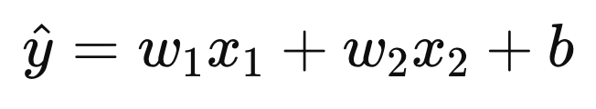
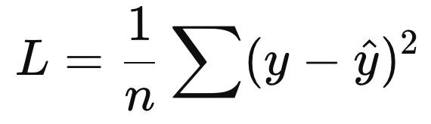
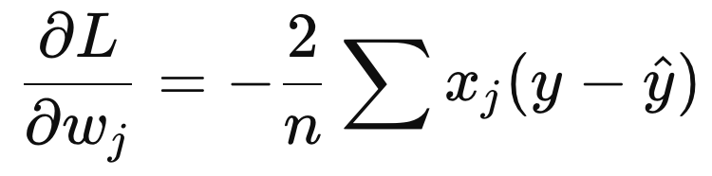
Feature Scaling
Example:
Temperature (°C) ≈ 15–40
Rainfall (mm) ≈ 0–300
The gradient is proportional to the feature value.
Large feature values → Large gradient → Larger weight update
Learning gets over-reliant on Rainfall

Slide 3
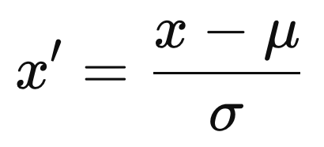
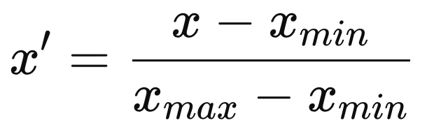
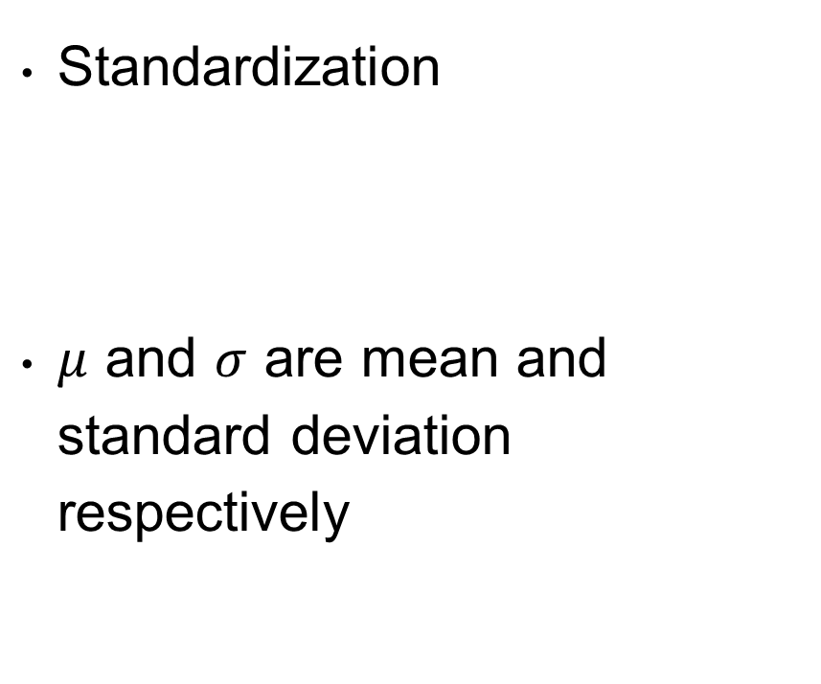
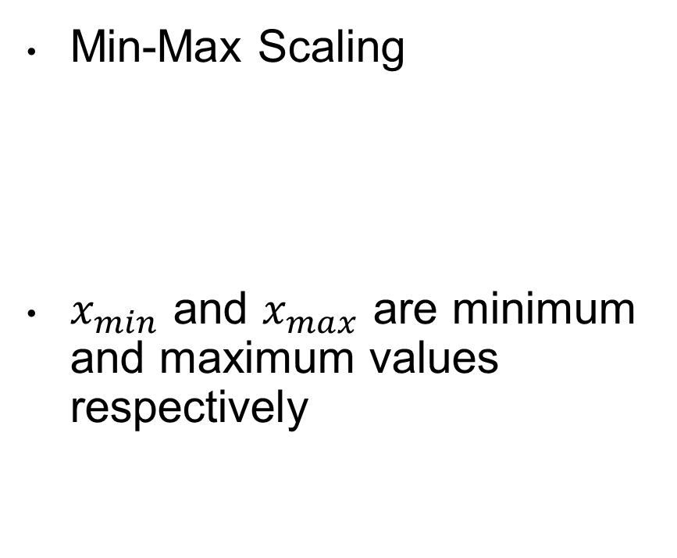
Feature Scaling
Standardization
$μ$ and $σ$ are mean and standard deviation respectively
Min-Max Scaling
$x_{min}$ and $x_{max}$ are minimum and maximum values respectively

Slide 4
Missing Value Imputation
Imputation: Process of turning incomplete samples into complete samples
Replace missing values with
Mean
Minimum
Median
etc
ML-based imputation techniques
Train a model to predict missing values
Ex: KNN-Imputer
Iterative imputation
EX: MICE
Many more

Slide 5
Data Augmentation
Noise Addition
Transformation
Rotate
Scale
Translate, etc
Synthetic Sample Generation
Handle Imbalance
SMOTE, Generative Modeling

Slide 6
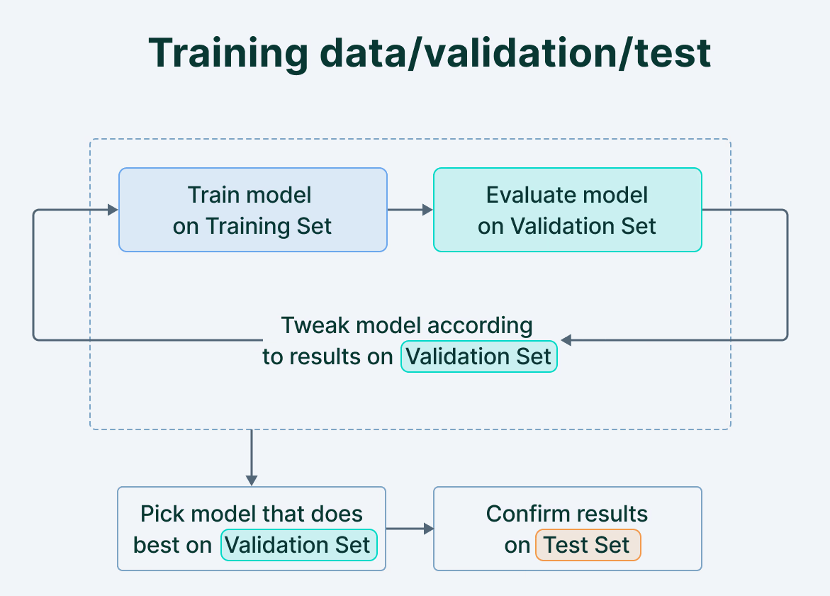
Training, Validation, and Test Split
Training Set
Used to train the models
Update model parameters
Validation Set
Used for model selection and hyper-parameter tuning
Test Set
Report model performance on test set
Generalization error
Avoid Data Leakage
Example: Avoid standardization using entire dataset

Slide 7
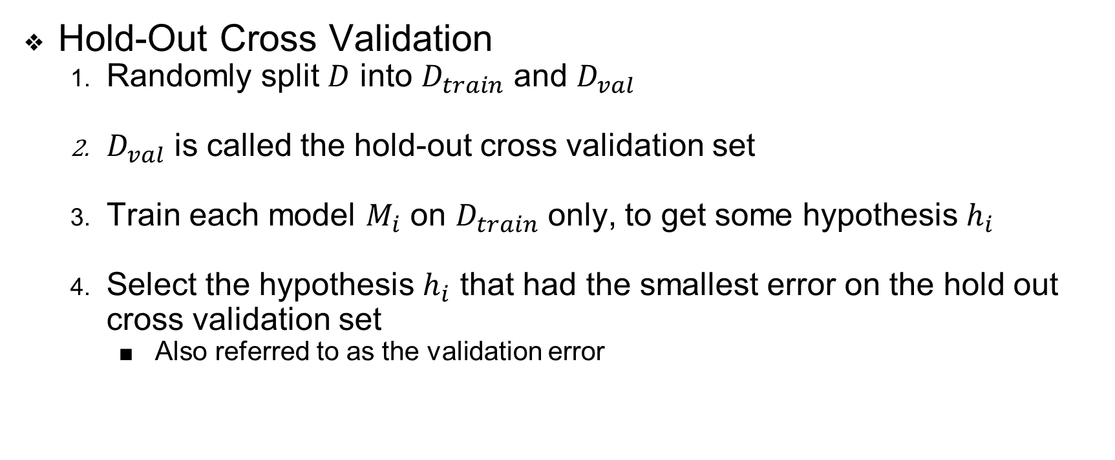
Cross Validation
Hold-Out Cross Validation
Randomly split $D$ into $D_{train}$ and $D_{val}$
$D_{val}$ is called the hold-out cross validation set
Train each model $M_{i}$ on $D_{train}$ only, to get some hypothesis $h_{i}$
Select the hypothesis $h_{i}$ that had the smallest error on the hold out cross validation set
Also referred to as the validation error

Slide 8
Cross Validation
When data is scarce
Cannot hold-out the validation set
k-Fold Cross Validation

Slide 9

Cross Validation
k-Fold Cross Validation
Randomly split D into k disjoint subsets
Treat each split as the validation set and the remaining as the train set
Pick the model with the lowest estimated generalization error
Retrain that model on the entire training set D
The resulting hypothesis is then output as our final answer

Slide 10
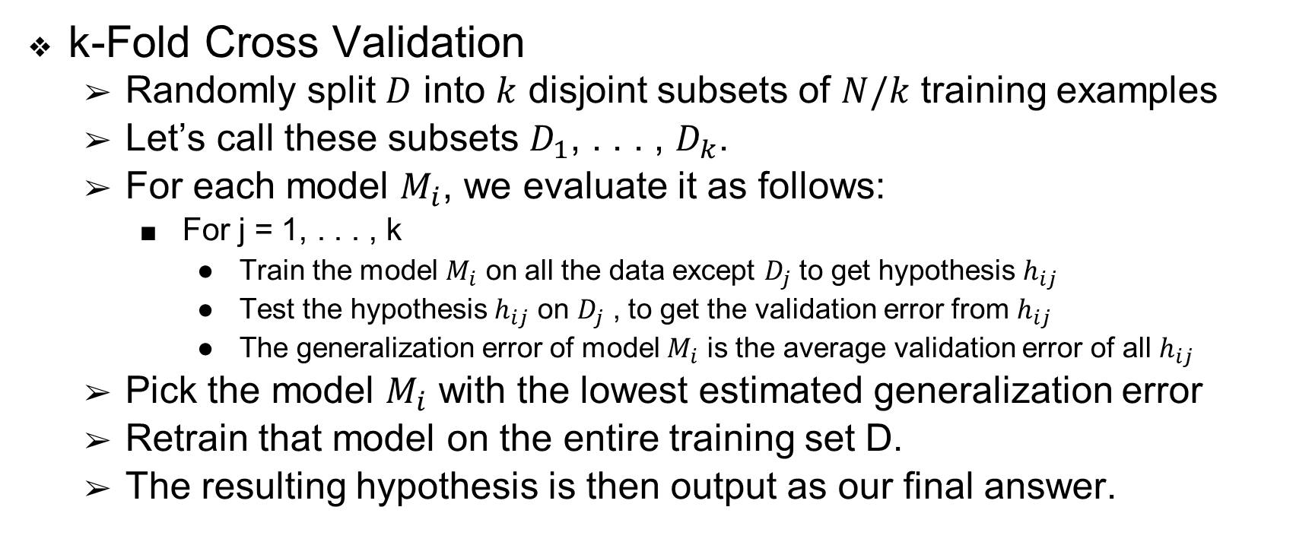
Cross Validation
k-Fold Cross Validation
Randomly split $D$ into $k$ disjoint subsets of $N/k$ training examples
Let’s call these subsets $D_{1}$, . . . , $D_{k}$.
For each model $M_{i}$, we evaluate it as follows:
For j = 1, . . . , k
Train the model $M_{i}$ on all the data except $D_{j}$ to get hypothesis $h_{ij}$
Test the hypothesis $h_{ij}$ on $D_{j}$ , to get the validation error from $h_{ij}$
The generalization error of model $M_{i}$ is the average validation error of all $h_{ij}$
Pick the model $M_{i}$ with the lowest estimated generalization error
Retrain that model on the entire training set D.
The resulting hypothesis is then output as our final answer.

Slide 11

Cross Validation
Stratified k-Fold Cross Validation
Randomly split $D$ into $k$ disjoint subsets of $N/k$ training examples
Each fold preserves the class proportions of the full dataset

Slide 12
Cross Validation
Leave-One-Out Cross Validation
k-Fold Cross Validation where k=N
Leave one sample out as validation set

Slide 13
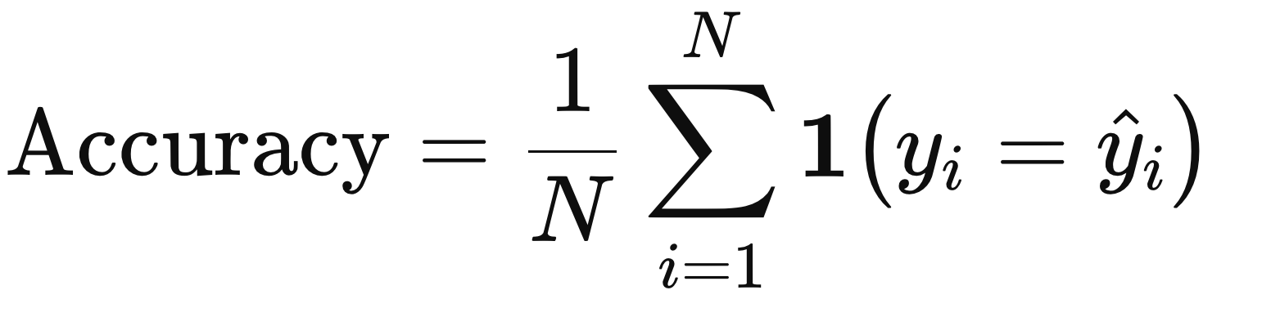
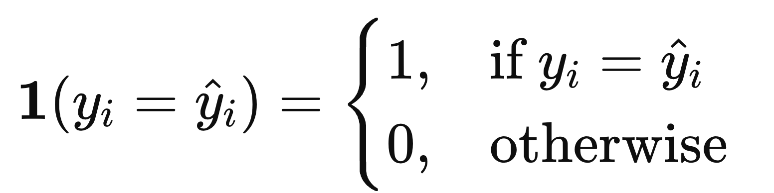
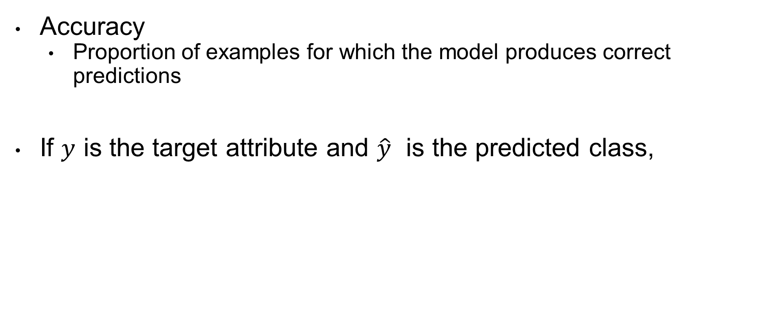
Performance Metrics
Accuracy
Proportion of examples for which the model produces correct predictions
If $y$ is the target attribute and $\hat{y}$ is the predicted class,

Slide 14
Performance Metrics
Consider a binary classification task
Positive and Negative Classes
- | Originally Positive (1) | Originally Negative (0)
Predicted Positive (1) | True Positive (TP) | False Positive (FP)
Predicted Negative (0) | False Negative (FN) | True Negative (TN)
Confusion Matrix

Slide 15
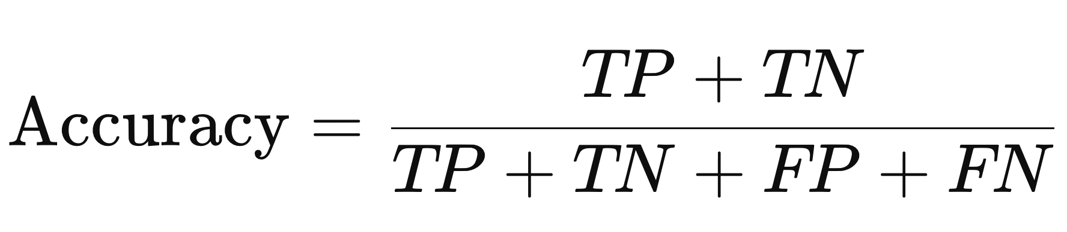
Performance Metrics
Accuracy
Proportion of examples for which the model produces correct predictions
Does higher accuracy indicate good model?
Imbalanced Dataset: What if 90% of the samples are positive and only 10% are negative. Example: Spam Email Classification
Prediction Cost: What if the cost of a False Positive is higher/lower than False Negative? Example: Recidivism Prediction, Medical Diagnosis

Slide 16
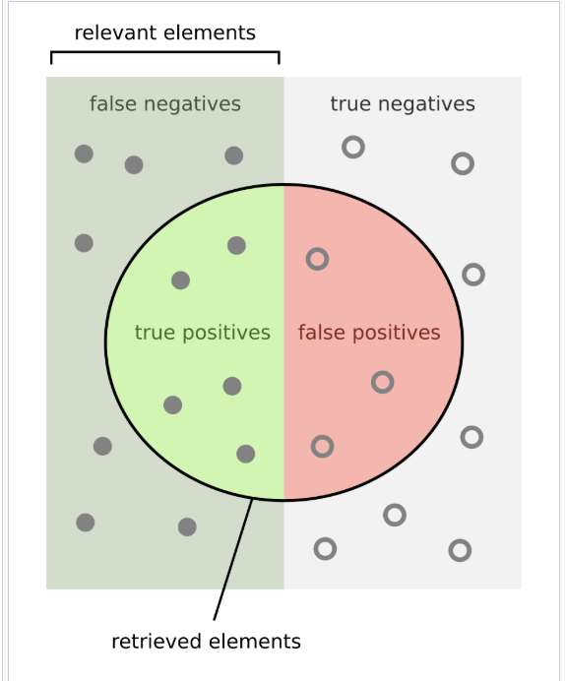
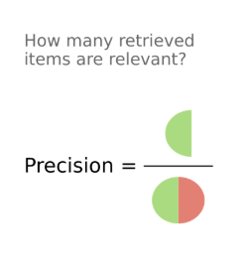
Performance Metrics
Precision

Slide 17
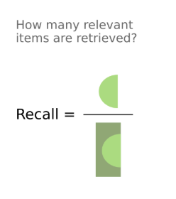
Performance Metrics
Recall

Slide 18
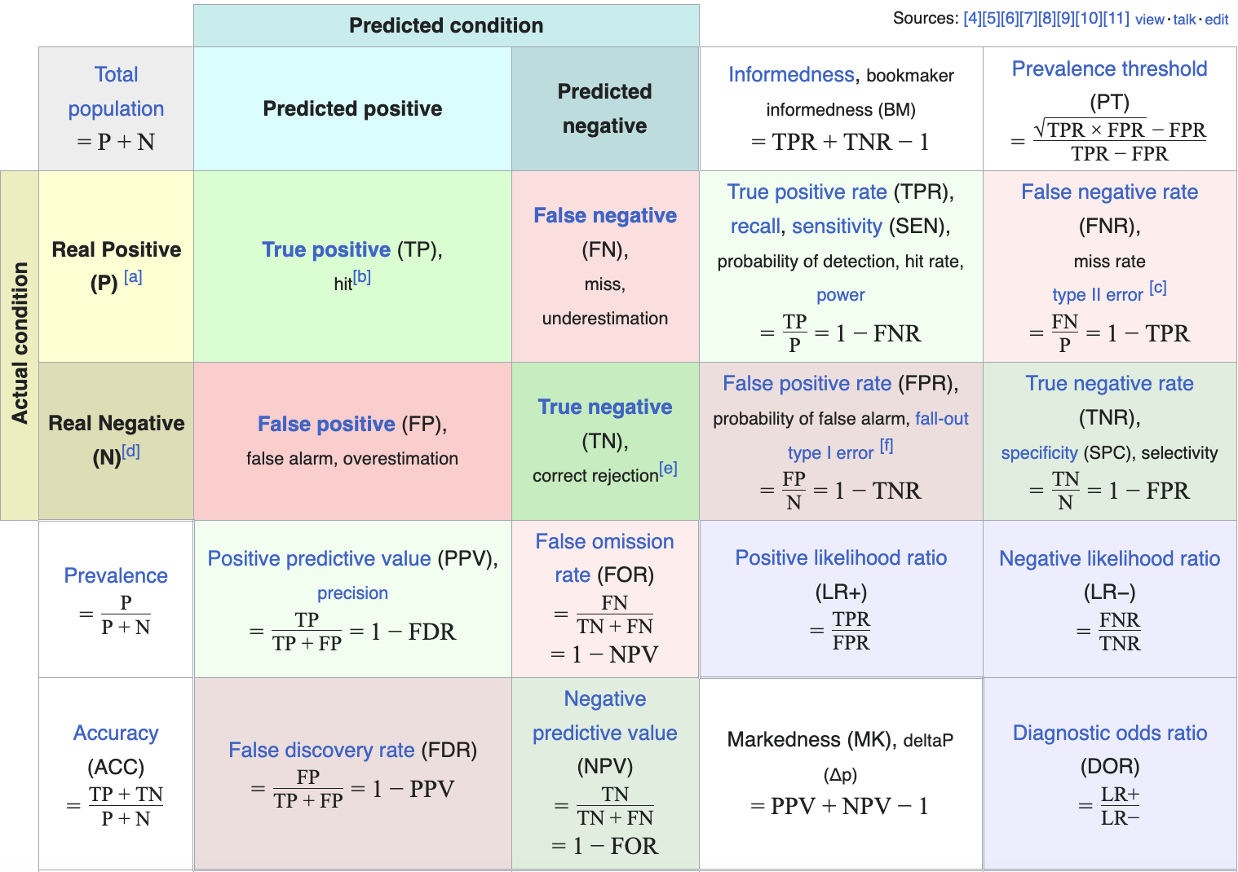
Performance Metrics
Precision
Recall

Slide 19
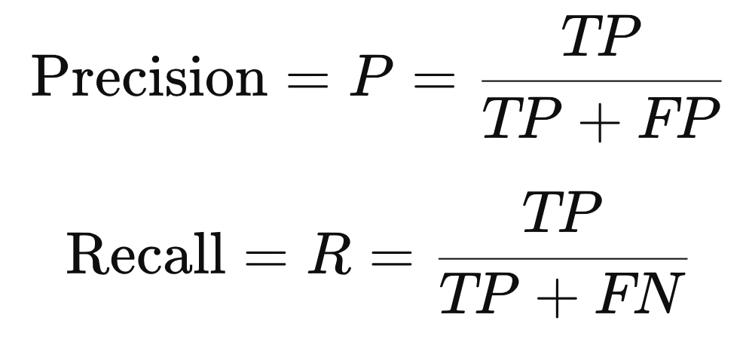
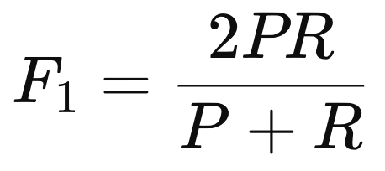
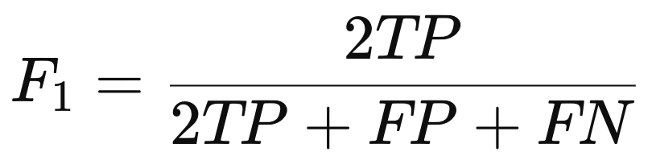
Performance Metrics
F1-Score
Achieve balance between precision and recall
Harmonic mean of Precision and Recall

Slide 20
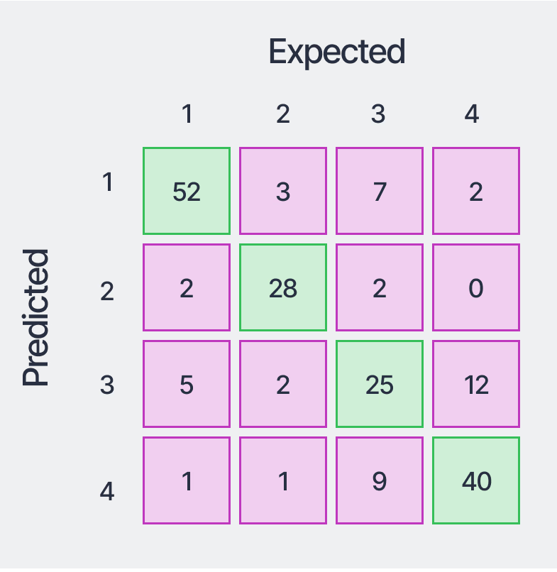
Performance Metrics
Performance on multi-class classification task
Accuracy
Confusion Matrix

Slide 21
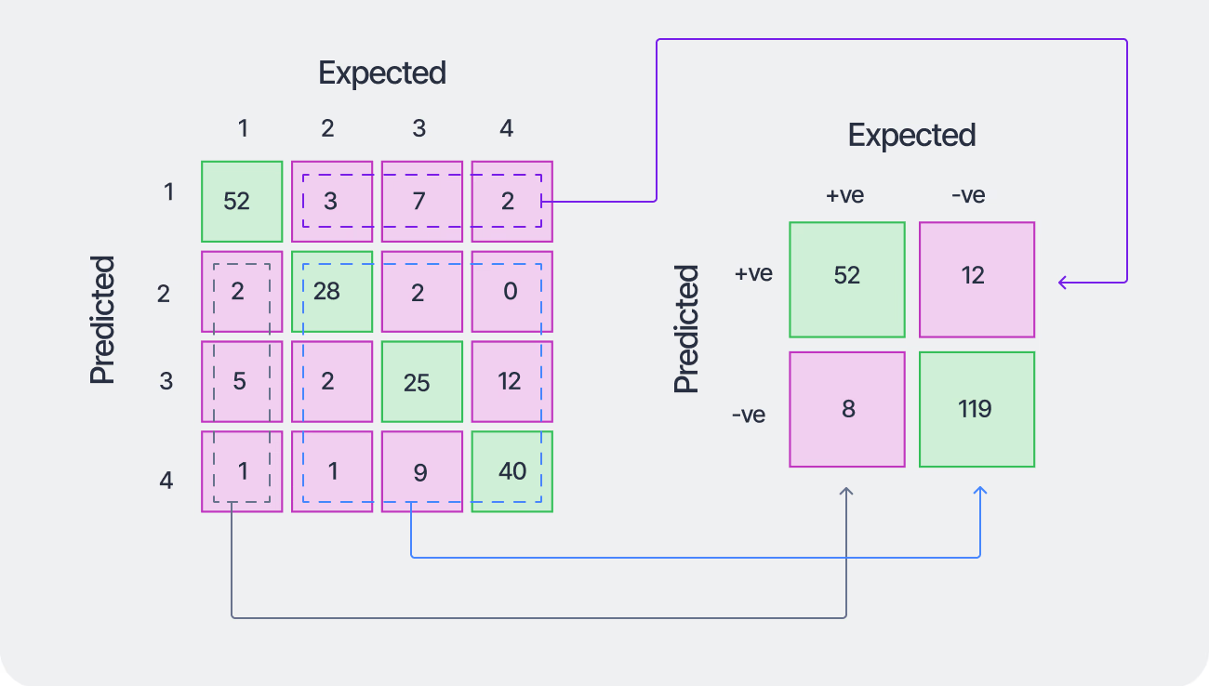
Performance Metrics
Performance on multi-class classification task
One-vs-All
One class is considered the positive class
The rest are negative class
Class-wise
Accuracy
Precision
Recall
F1-Score
Confusion Matrix

Slide 22
Performance Metrics
Performance on multi-class classification task
Obtain Global Metric
Micro-Averaging
Macro-Averaging
Weighted-Averaging
Confusion Matrix

Slide 23
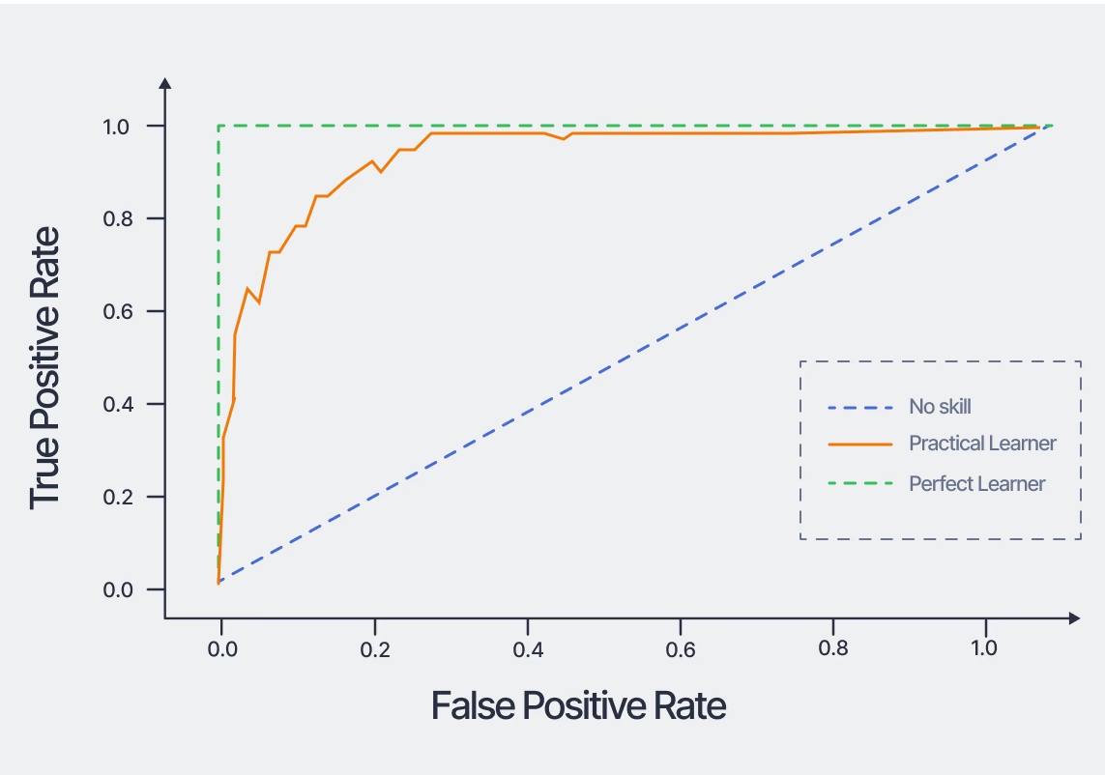
Area Under Receiver-operating characteristic curve (ROC)
A threshold invariant metric
Plot the TPR vs FPR curve by varying the prediction threshold
Report the Area Under the Curve (AUC)
High AUC means the model usually assigns higher scores to positive examples than to negative ones.

Slide 24
References
CS229 Leture Note
Cross Validation: Section 9.3
Performance Metrics
https://en.wikipedia.org/wiki/Precision_and_recall
https://www.v7labs.com/blog/confusion-matrix-guide
https://developers.google.com/machine-learning/crash-course/classification/roc-and-auc

